Slide 1

Data Visualization & Analysis
GROUP A
Chandan Acharya
Devendra Hupri
Rakesh Lagare
Nagesh TR

Slide 2

Dataset used
World Data Bank
It is the primary World Bank collection of development indicators, compiled from officially recognized international sources. It presents the most current and accurate global development data available, and includes national, regional and global estimates.
Link: http://databank.worldbank.org/data/home.aspx

Slide 3
Variables
Percentage of service exports and imports for Germany from 2001 to 2016
Indicator Name | Long definition
Transport services (% of commercial service exports) | Transport services (% of commercial service exports) covers all transport services
Transport services (% of commercial service imports) | Transport services (% of commercial service exports) covers all transport services

Slide 4
Method used
SVM: Support Vector Machines
Linear SVM is a linearly scalable routine
It creates an SVM model in a CPU time which scales linearly with the size of the data set

Slide 5
FEATURES
Efficiency in dealing with extra large data sets
Solution of multiclass classification problems with any number of classes.
Working with high dimensional data in both sparse and dense format,
No need for expensive computing
Ideal for contemporary applications in e-commerce, web page categorization, text classification, proteomics, banking services and many other areas.

Slide 6
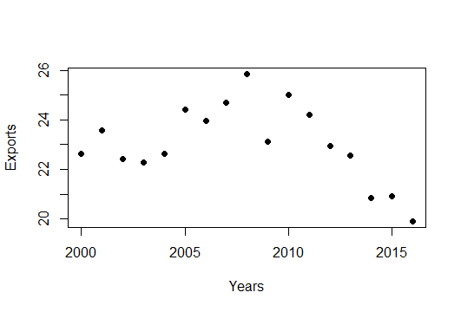
SVM IMPLEMENTAION
#Plotting the dataset
plot(train,pch=16)

Slide 7
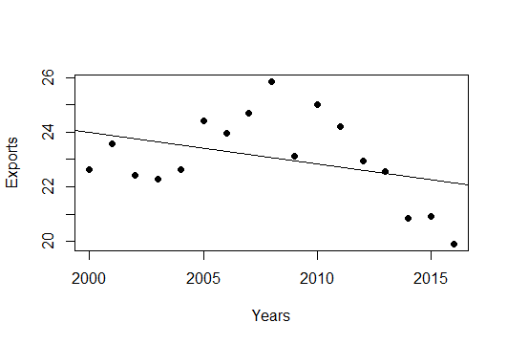
SVM IMPLEMENTAION
#Linear regression
model <- lm(Exports ~ Years, train)
#Plot the model using abline
abline(model)

Slide 8
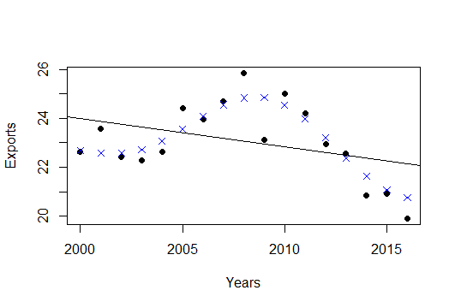
SVM IMPLEMENTAION
#Fit a model. The function syntax is very similar to lm function
model_svm <- svm(Exports ~ Years , train)
#Use the predictions on the data
pred <- predict(model_svm, train)
#Plot the predictions and the plot to see our model fit
points(train$Years, pred, col = "blue", pch=4)

Slide 9
SVM IMPLEMENTAION
#Error Analysis for LM
error <- model$residuals
lm_error <- sqrt(mean(error^2))
>>1.414094
#Error Analysis for SVM
error_2 <- train$Exports - pred
svm_error <- sqrt(mean(error_2^2)
>>0.69203

Slide 10
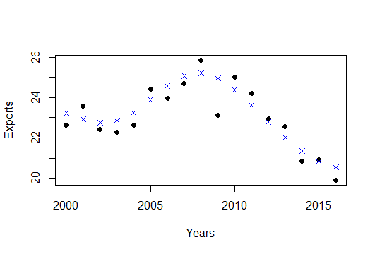
SVM IMPLEMENTAION
However, the SVM model goes far beyond that. We can further improve our SVM model and tune it so that the error is even lower.

